Slide 1
Electronic Distance Measurement

Slide 2
Electronic Distance Measurement
Electronic distance measuring instrument is a surveying instrument for measuring distance electronically between two points through electromagnetic waves.
Electronic distance measurement (EDM) is a method of determining the length between two points, using phase changes, that occur as electromagnetic energy waves travels from one end of the line to the other end. As a background, there are three methods of measuring distance between two points:

Slide 3
DDM or Direct Distance Measurement
This is mainly done by chaining or taping.
ODM or Optical Distance Measurement
This measurement is conducted by tacheometry, or telemetric method. These are carried out with the help of optical wedge attachments.

Slide 4
EDM or Electromagnetic Distance Measurement
EDM is very useful in measuring distances that are difficult to access or long distances. It measures the time required for a wave to sent to a target and reflect back. Electronic distance measurement in general is a term used as a method for distance measurement by electronic means. In this method instruments are used to measure distance that rely on propagation, reflection and reception of electromagnetic waves like radio, visible light or infrared waves.

Slide 6
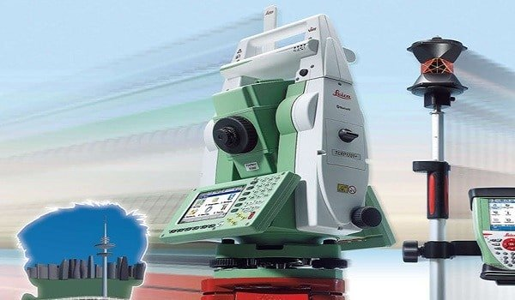
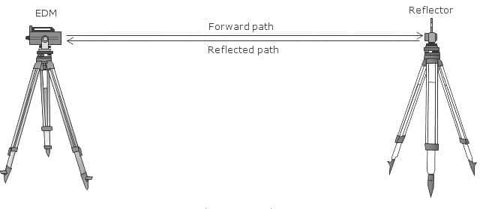
Electromagnetic Distance Measurement

Slide 7
Instrumental Errors
Calibration errors
Chances of getting maladjusted time to time generating frequent errors
Errors shown by the reflectors
Natural Errors
Atmospheric variations in temperature, pressure as well as humidity. Micro wave EDM instruments are more susceptible to these.
Multiple refraction of the signals.
The advantage of using EDM instruments is the speed and accuracy in measurement. Several obstacles to chaining are automatically overcome when these instruments are used.

